Slide 1


A BIRTH OF AN INTERNET STAR
Web2 Summit 2011

Slide 2
What is the Independent Web and Why Does it Matter?
Basic Tenets
It’s the Web’s Growth Engine
☑
The Independent Web is comprised of online properties that are not owned and operated by large media companies
113
People read independent websites on a monthly basis in 2010
MM
☑
Social in nature, the Independent Web is a source of conversation online – where ideas and narratives are born and shared
133
Expected size of the independent audience in 2012
MM
☑
Users seek out and follow the most unique and powerful voices who are relatable to their own passions
150
Expected size of the independent audience in 2014
MM
eMarketer, “The Blogosphere: Colliding with Social and Mainstream Media” Sept 2010

Slide 3
The Birth Of an Internet Star
1.
SCALE. A new service erupts on the web, bringing with it rapid user adoption and substantial cultural buzz. Shiny! New! At scale!
2.
DATA. The service garners massive investments of risk capital to fund infrastructure and product development so as to scale against massive user demand and build out a unique dataset/graph.
3.
ACCESS. Marketers clamor to “get on” the new service, and are frustrated by the lack of customer service, intelligent advertising products, or general regard for their needs.
4.
PLATFORM. The service eventually figures out its monetization strategy, hires a sales force, proves its value, gets a seat at the upfront table, and goes public.

Slide 4





The Independent Web’s Problem
SCALE
DATA
ACCESS
PLATFORM
600mm in 15 years
Content
Display Ads
.com, RMX
775mm in 10 years
Link Graph
Search Ads
.com, AdX
775mm in 6 years
Social Graph
Engagement Ads
.com, TBA
Interest Graph
Promoted Suite
.com, TBA
400mm in 4 years
600mm in 5 years
?
?
?

Slide 5

The Independent Web’s Opportunity
SCALE
DATA
ACCESS
PLATFORM
600mm in 15 years
Content
Display Ads
.com, RMX
775mm in 10 years
Links/PageRank
Search Ads
.com, AdX
775mm in 6 years
Social Graph
Engagement Ads
.com, TBA
400mm in 4 years
Interest Graph
Promoted Suite
.com, TBA
600mm in 5 years
Conv. Graph
CT suite
.coms, TBA

Slide 6
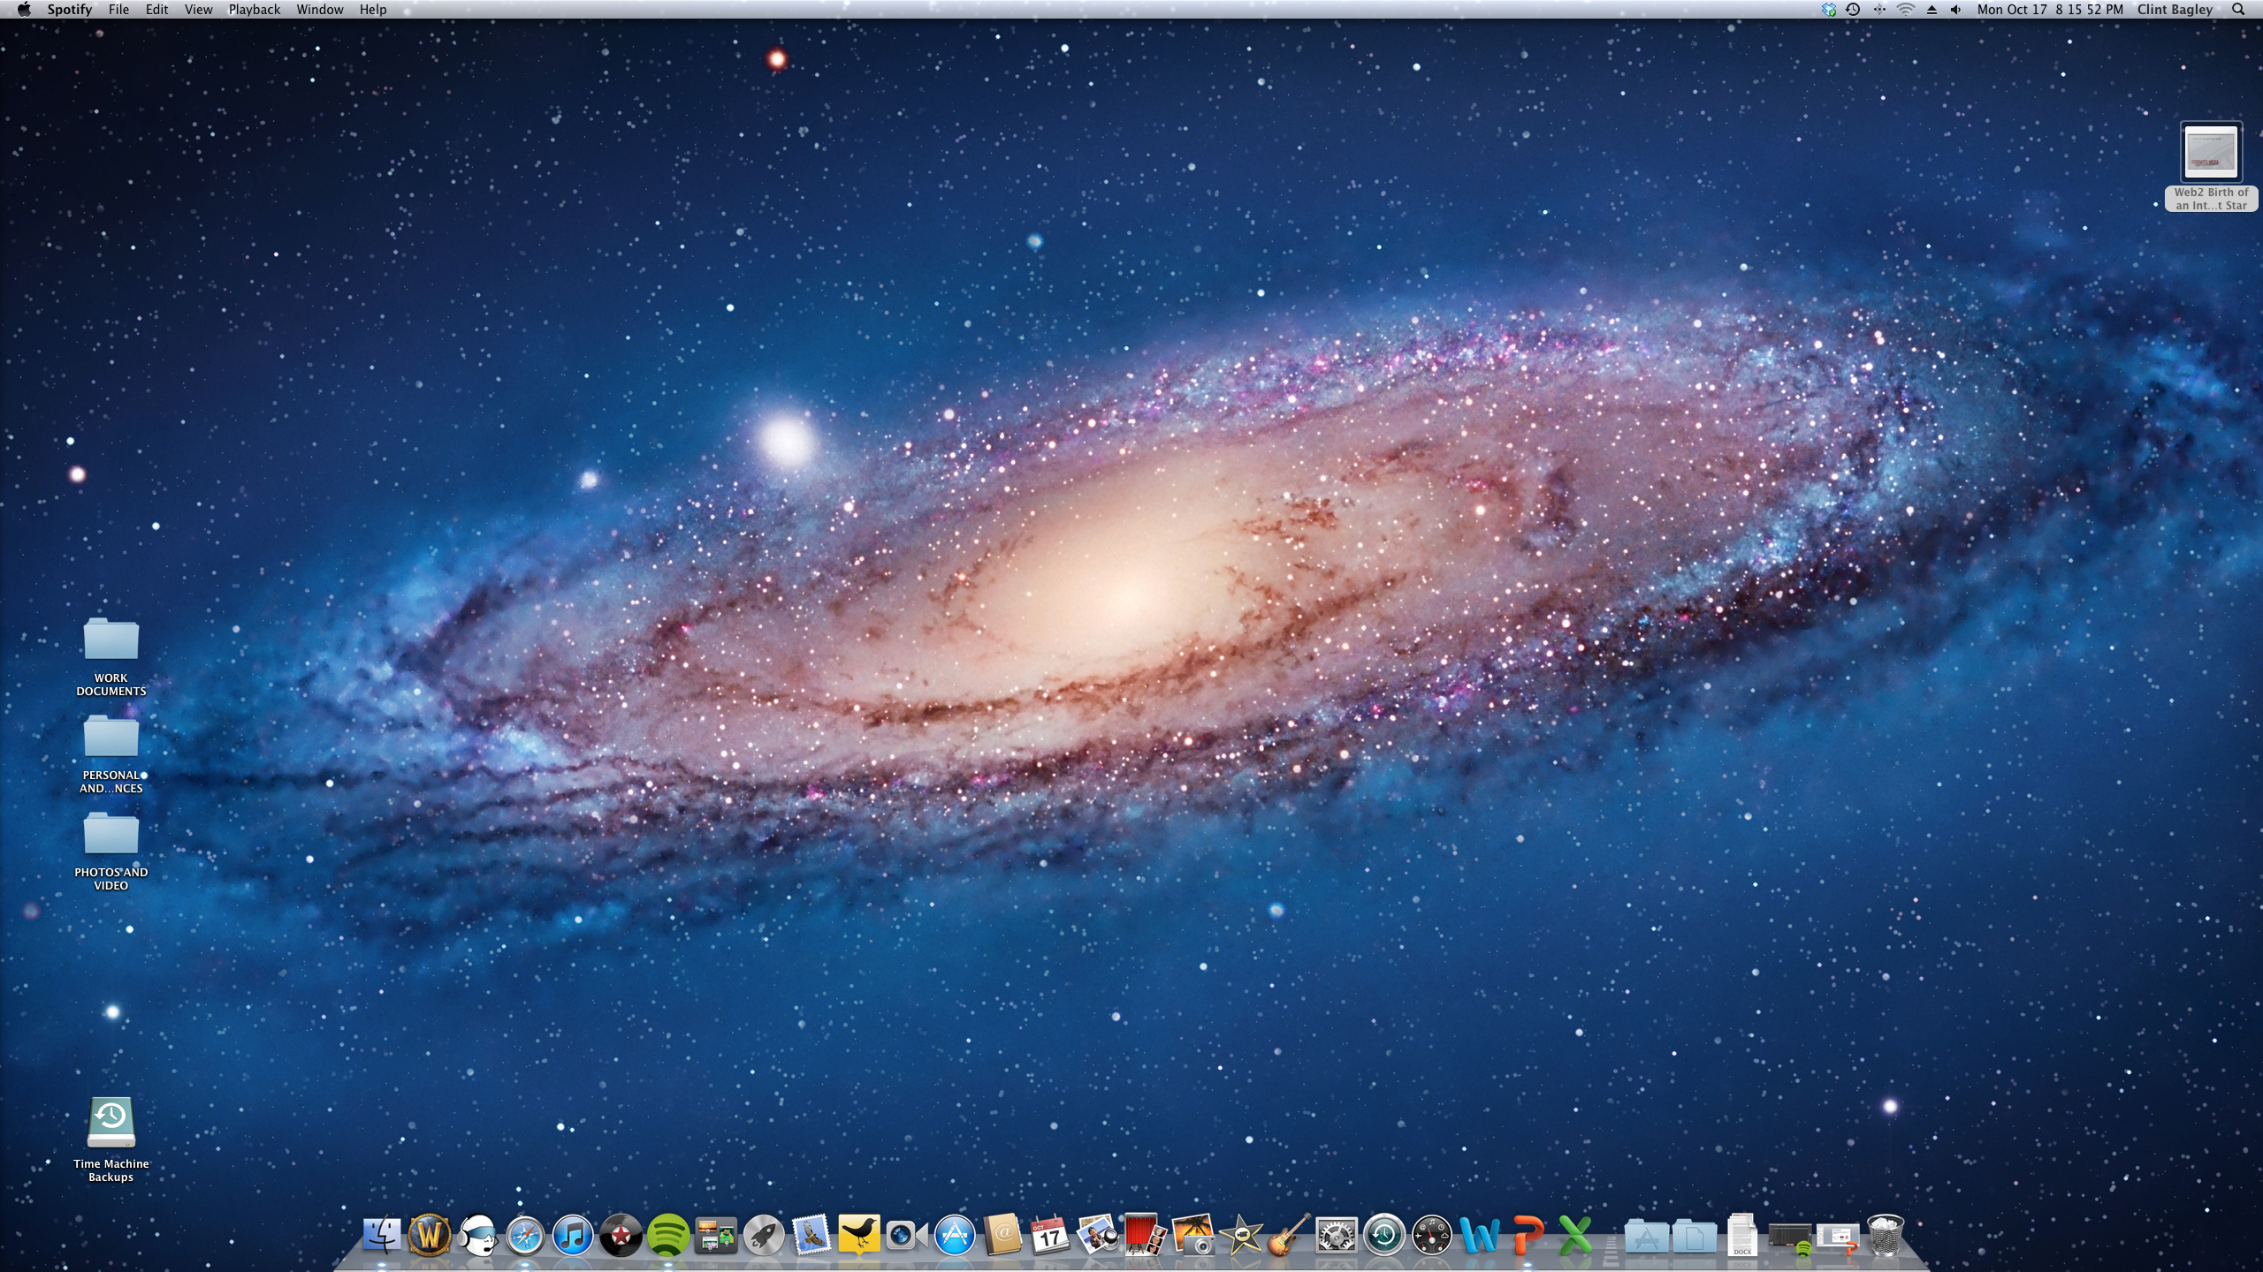

Announcement: FMP & wordpress
FMP offers marketing partners the first opportunity to advertise on the largest, most powerful publishing platform online: WordPress.com
Best Content
Right Context

Slide 7
FM & AutomatTic partnership
True Partners with a deep understanding of the Independent Web
Fast growing publisher services for Millions of Authors
Hundreds of Millions of Consumers engaged in conversational media
First ever opt-in premium ad program for top WordPress.com publishers

Slide 8
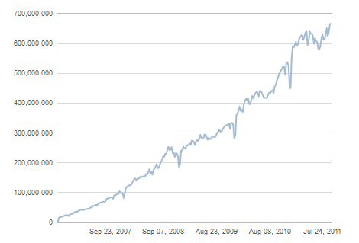
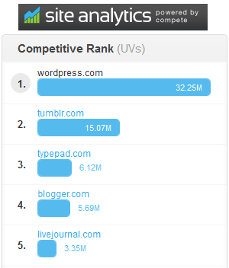

WordPress.com: Massive Scale
25m bloggers, 300m readers, 1.2m daily interactions, 3b monthly pageviews
From individual bloggers to enterprise customers
WordPress powers 15% of top 1m web sites, 22% of all new domains registered
WP.com weekly PV growth

Slide 9
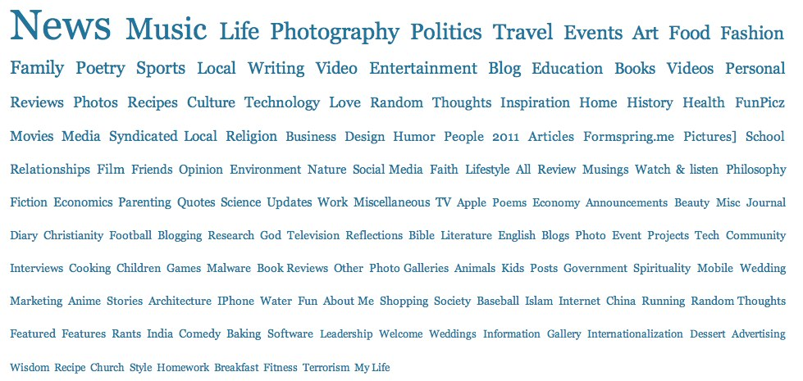
WordPress.com publishers cover the gamut of content interests

Slide 10

FMP NOw has relevance at scale with an influential audience
YOUNG
affluent
influential
34
Million
Are 18-34 year olds
(129 index)
More than Glam Media, Viacom Digital, CBS Interactive
22
Million
Have HHI >
$100K
(136 index)
More than Turner Digital, New York Times Digital, Apple Inc.
47
MILLION
Create and Share Digital Content At Least a Few Times a Month (61% reach with that audience)
More than MTV Networks, LinkedIn, Netshelter
Source: comScore Plan Metrix, August 2011. Data takes into account unduplicated data between Federated Media Publishing, WordPress.com, Lijit Networks, and Foodbuzz Network.
Notes:
Main point: we have scale AND composition
Customize this data set to a specific client's target audience/objectives

Slide 11


Our COMBINED consumers are trendsetters
This audience is the first amongst friends to own/buy/use the latest on the following types of products
21MM
(58% reach)
9MM
(64% reach)
14MM
(51% reach)
8MM
(62% reach)
Electronics
Home Décor &
Home Repair
Computer Hardware/Software
Health (Dieting and/or Exercising)
7MM
(69% reach)
9MM
(54% reach)
32MM
(54% reach)
4MM
(74% reach)
Financial Information
Food & Beverage
Movies/Music/TV/Gaming
Parenting/Family

Slide 12

WINNING COMBINATION
+
+
=
Dominance of
THE INDEPENDENT WEB
The New Internet Star!

